Slide 1



PROFESSOR MATH
By:
Anjali 22CSU019
Ankit Das 22CSU216
Aaryan Brar 22CSU219
Deepanshu Mehra 22CSU209
01

Slide 2

Github Link: https://github.com/Ankyytt/ProfessorMath
MYLANG: A MINIMAL JAVA INTERPRETER
Programming languages need interpreters to run code.
MyLang is a lightweight Java interpreter focused on math.
Includes a JavaFX GUI to visualize interpreter workings.
02

Slide 3

PROBLEM SOLVING
Problem:
Beginners don't understand how real programming languages like Python or JavaScript work internally.
Available interpreters are too complex or lack interactive features.
Our Solution (ProfessorMath):
Build a simple yet powerful custom interpreter.
Visual + practical learning: GUI with real-time execution.
Support important programming concepts: variables, functions, matrices.
04

Slide 4
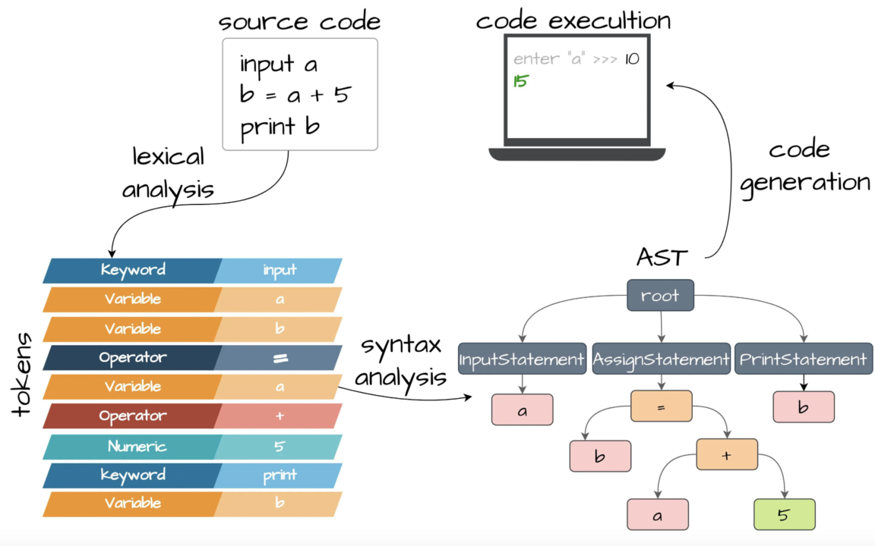
INTRODUCTION
BREAKING DOWN TASKS
In our project, ProfessorMath (MyLang), we simulate how a real programming language works internally.
First, when the user writes source code, it undergoes lexical analysis, where the code is broken down into smaller parts called tokens (like keywords, variables, operators, numbers).
Next, through syntax analysis, these tokens are organized into a logical structure known as an Abstract Syntax Tree (AST), which represents the flow and relationships of the code.
The evaluator then reads this AST, performs calculations, and produces the final output.
Finally, the code execution is displayed through a user-friendly GUI built in JavaFX.
This flow — from source code to output — helps beginners understand how interpreters like Python or JavaScript actually process and run programs internally.
07

Slide 5

CODING SKILLS
Java Programming (OOP Concepts)
Lexical Analysis (Lexer Creation)
Parsing and AST Construction
GUI Development using JavaFX
Matrix Operations (Addition & Multiplication)
Built-in Math Function Integration
Error Handling and Debugging
Event-driven Programming (GUI Buttons)
03

Slide 6
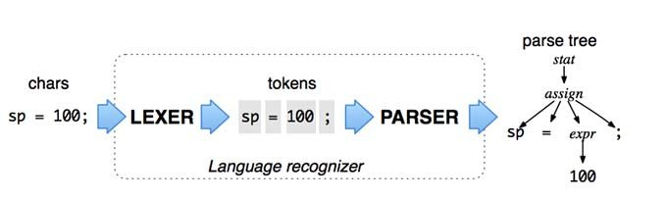
IMPLEMENTATION ARCHITECTURE
Input ➔ Lexer ➔ Parser ➔ AST ➔ Evaluator ➔ Output
08

Slide 7



LEXER (LEXICAL ANALYSIS)
Lexer is the first step in processing code.
It breaks the source code into small pieces called tokens.
Tokens represent keywords, variables, operators, numbers, etc.
Example:
Input: let x = 5 + 3
Lexer generates: [let] [x] [=] [5] [+] [3]
These tokens are passed to the Parser for further understanding.
11

Slide 8
🧩 PARSER (SYNTAX ANALYSIS)
Parser takes the tokens generated by the Lexer.
It arranges tokens into a logical structure following grammar rules.
This structure is called an Abstract Syntax Tree (AST).
AST shows how different parts of the code relate (e.g., assignments, operations).
Example:
let x = 5 + 3 ➔ becomes an AST with nodes for assignment and addition.
11

Slide 9
🌳 AST (ABSTRACT SYNTAX TREE)
The AST is a tree-like structure representing the logic of the code.
Each node in the AST corresponds to an operation, variable, number, function, or matrix.
AST simplifies complex code into understandable parts for the evaluator.AssignmentNode
├── VariableNode(x)
└── BinaryOperationNode(+)
├── NumberNode(5)
└── NumberNode(3)
11

Slide 10
🧠 EVALUATOR (EXECUTION ENGINE)
The Evaluator reads the AST and performs calculations.
It executes:
Arithmetic operations (+, -, *, /)
Variable assignments and lookups
Function calls (sin, cos, sqrt, log)
Matrix operations (addition, multiplication)
Evaluator walks through each node and computes final output.
Example:
AST for let x = 5 + 3 ➔ Evaluator computes 8 and stores it under x.
11

Slide 11
TECH STACK
Key Features
Supports variables, arithmetic, functions, matrices
Real-time feedback, error handling
GUI with Dark Mode and Guide
Complete compilation pipeline: Lexer → Parser → AST → Evaluator
Component | Technology | Purpose
Core Engine | Java | Language Interpreter
GUI Framework | JavaFX | User Interface
Math Operations | Java Math + Custom | Built-in and custom math
Tokenization | Custom Lexer | Break input into tokens
Parsing | Custom Parser | Build AST
Evaluation | Evaluator | Execute code
Special Feature: Matrix Engine
2D Matrix support
Add and multiply matrices
Custom Matrix.java class handles math
User Interface (GUI)
Built with JavaFX
Input & Output text areas
Buttons: Run, Clear, Guide, Dark Mode
Bonus: Real-time hints & error feedback
09

Slide 12
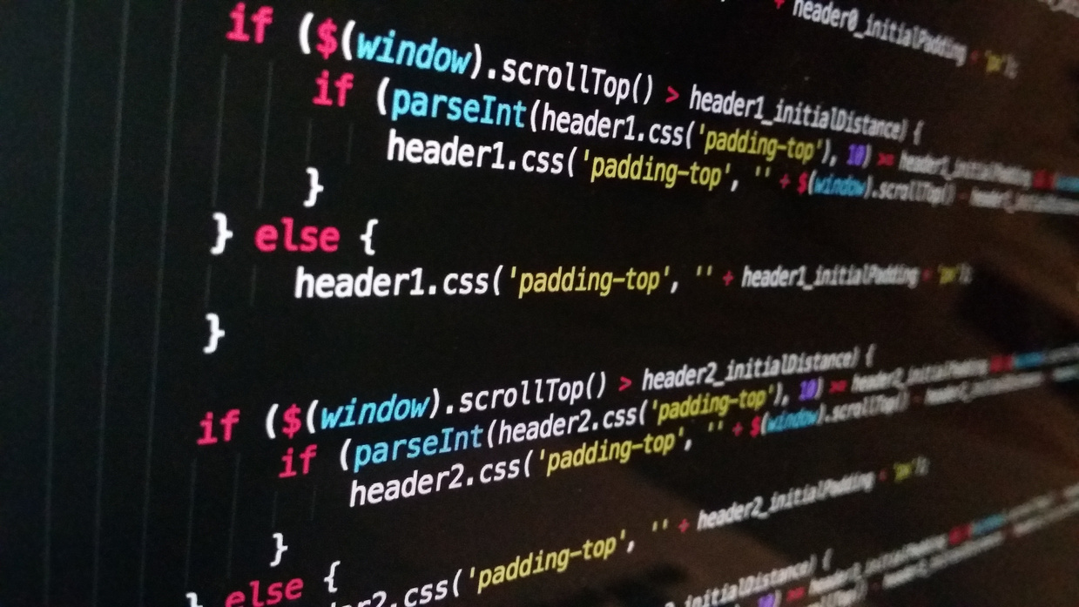


Studio Shodwe
CONCLUSION & FUTURE SCOPE
Simulated real interpreter concepts
Great for learning Java + compiler/interpreter basics
Future Improvements:
Add loops and conditionals
Expand matrix operations
Export code/output functionality
11

Slide 13


THANK YOU
GitHub Link:https://github.com/Ankyytt/ProfessorMath
10

